Slide 1


CUSTOMER CHURN
PRESENTED BY:
KINA GAJIPARA (8850437)
PRERNA KAPANI (8984047)
SNEHA PATEL (8962629)
NITIGYA VASUDEV (8977453)
FALGUN PARIKH (8994929)

Slide 2


INTRODUCTION OF PROJECT
Objective: Analyze customer characteristics and service usage to predict churn and develop retention strategies.
Process: Clean and transform data, followed by visualization and analysis, to build and evaluate predictive models.
Outcome: Create a model to forecast customer churn and inform customer loyalty programs for improved retention.

Slide 3


PROBLEM STATEMENT
Problem: High customer churn negatively affects financial stability and growth.
Challenge: Predict customer departure using characteristics and service usage patterns.
Goal: Develop models to identify churn factors and implement retention strategies to improve customer satisfaction and reduce attrition.

Slide 4

ABOUT DATASET
Customer Demographics: Includes customer gender, senior citizen status, partnership, and dependent status.
Account Information: Covers tenure with the company, contract type, paperless billing status, payment method, and monthly/total charges.
Service Information: Details various services such as phone, internet, and add-ons like online security, backup, and streaming options.
Target Variable: Indicates if the customer has churned in the last month (Yes/No).

Slide 5

DATA PREPROCESSING
Handling Missing Values: Removed rows with missing values in the TotalCharges column after converting it to numeric format.
Encoding Categorical Variables: Applied label encoding for binary variables and one-hot encoding for multi-class variables to prepare for modeling.
Scaling Numerical Features: Standardized features like tenure, MonthlyCharges, and TotalCharges to ensure equal contribution and consistency in analysis.

Slide 6
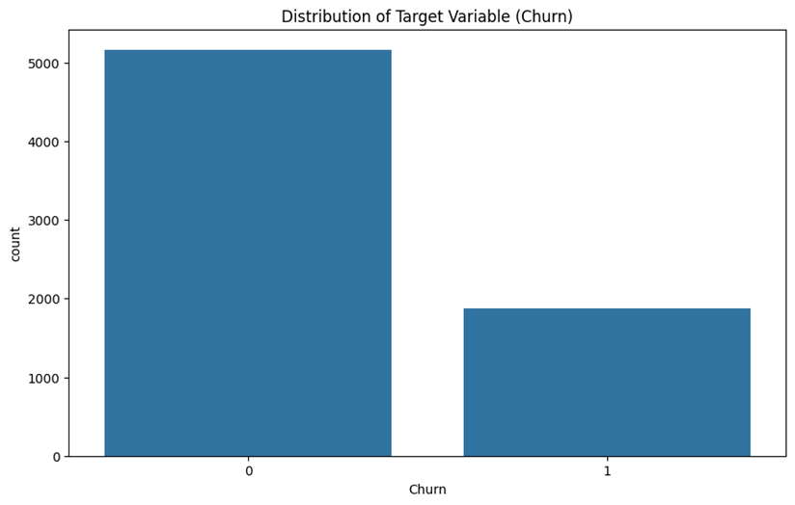
Distribution of Churn
Imbalanced Data: The majority class (customers who did not churn) significantly outnumbers the minority class (customers who churned).
Class Distribution: Approximately 25% of customers churned, while 75% did not.
Implication: The model may need techniques like resampling or using specialized metrics to address this class imbalance.

Slide 7
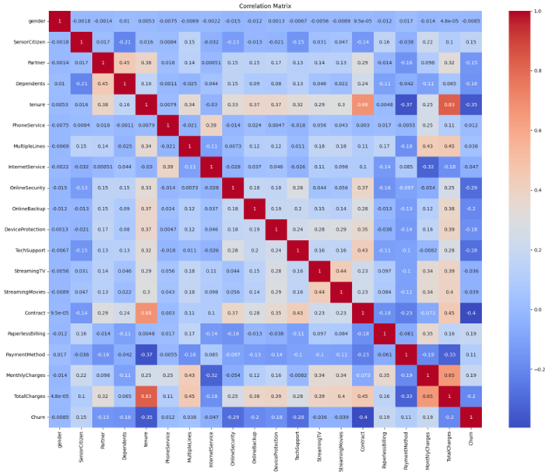
Correlation Matrix
Churn Factors: Monthly charges and tenure are significant factors in customer churn, with higher charges and lower tenure leading to higher churn.
Tenure is highly correlated with TotalCharges (0.83), as the longer a customer stays, the higher their total charges.
There is a weaker negative correlation between Contract and churn (-0.19), suggesting that customers on longer contracts are less likely to churn.

Slide 8
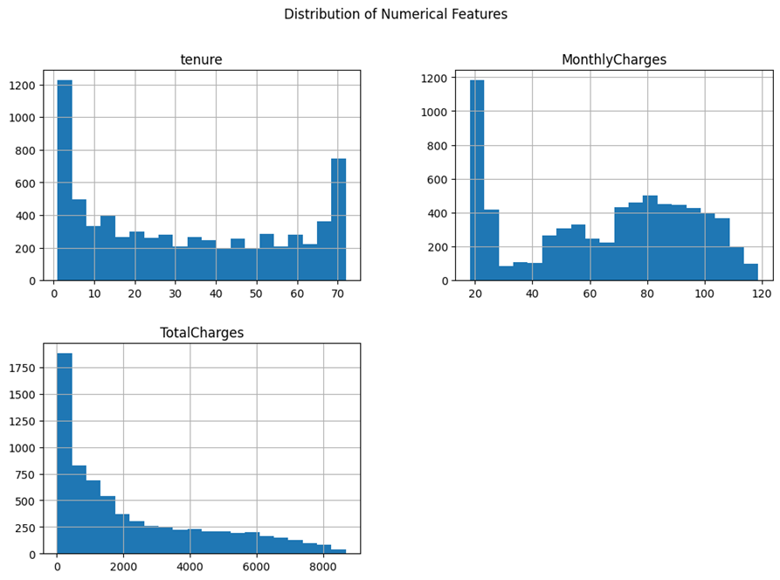
Distribution of Numerical Features
Tenure:
Distribution: Most customers have either very low or very high tenure, indicating two distinct customer groups.
Churn Insight: Customers with shorter tenure are more likely to churn.
Monthly Charges:
Distribution: Monthly charges show a relatively uniform distribution with a peak around $70-$100.
Churn Insight: Higher monthly charges might be associated with higher churn rates.
Total Charges:
Skewness: Total charges are heavily skewed towards lower values.
Churn Insight: Customers with lower total charges tend to churn more.

Slide 9
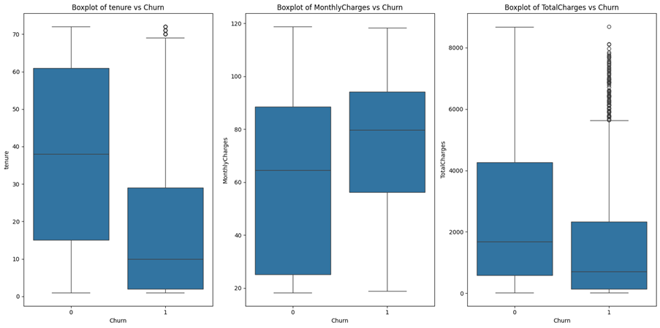
Box plot of features vs Churn
02

Slide 10
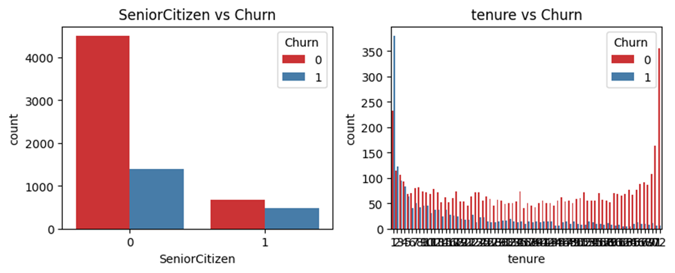
CATEGORICAL VARIABLE ANALYSIS
Senior Citizens: Senior citizens are more likely to churn compared to non-senior citizens.
Service Relationships: Bundled services like internet service, online security, and tech support show correlations, indicating that customers often subscribe to multiple related services.
Customer Retention: Strategies focusing on retaining customers in their early tenure and offering better contracts could reduce churn rates.

Slide 11

Conditional Probability Analysis
MARKET SIZE
OUR CLIENTS COME FROM EVERYWHERE
Helps in assessing the likelihood of churn given specific customer features, such as internet service type.
Assesses how individual features impact the target variable (churn).
Conditional Probability Result:
Fiber Optic Internet Service: Customers with this service have a 7.43% likelihood of churning.

Slide 12
Hypothesis Testing
Statistical Significance: Determines if observed patterns (e.g., between contract type and churn) are statistically significant.
Feature Importance: Identifies if certain features (e.g., Contract type) have a significant association with churn.
Chi-square Test Result:
Statistic: 1179.5458.
P-value: 0.0000.
Reject the null hypothesis. There is a significant association between Contract type and Churn.
Focus on optimising contract types to reduce churn rates based on significant findings.

Slide 13

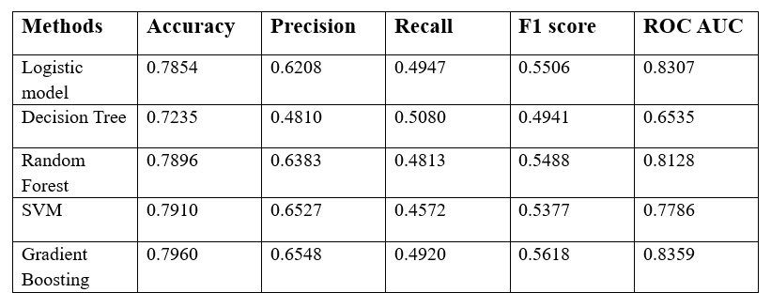
MODEL EVALUATION

Slide 14
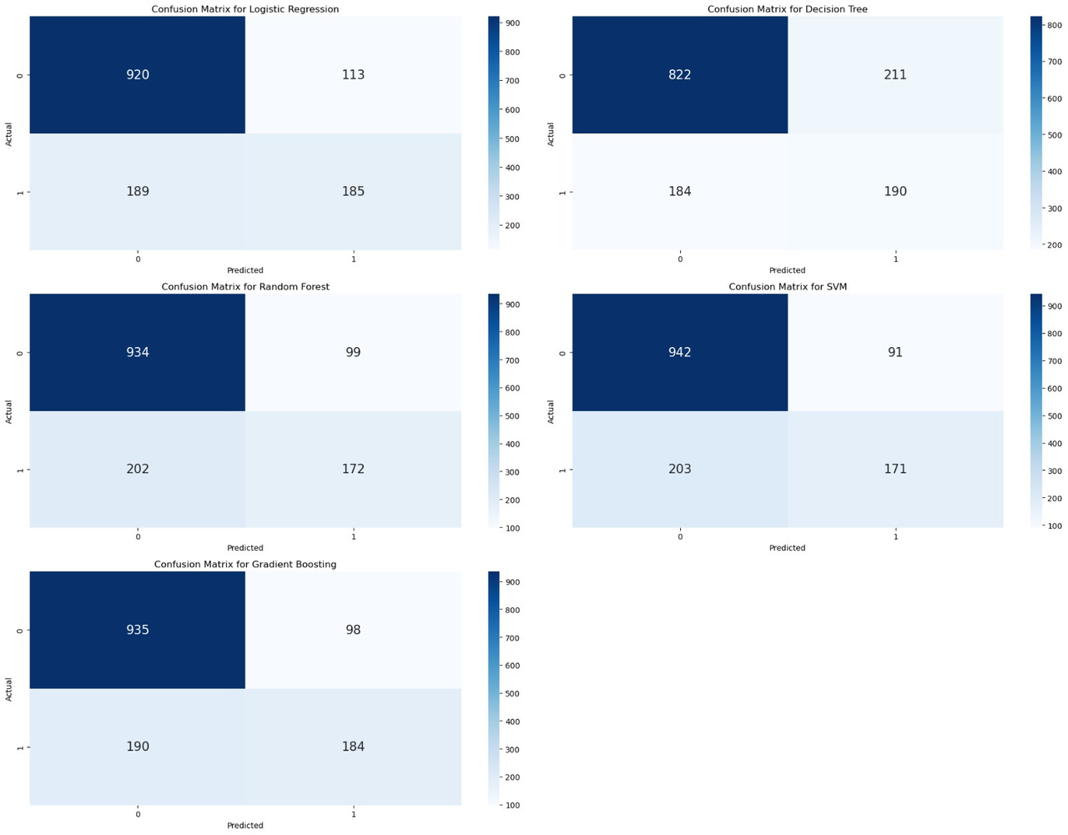
Confusion Matrix
TN: SVM and Gradient Boosting had the highest true negatives.
FP: SVM had the fewest false positives.
FN: High false negatives across all models.
TP: Gradient Boosting and Logistic Regression had the highest true positives.

Slide 15
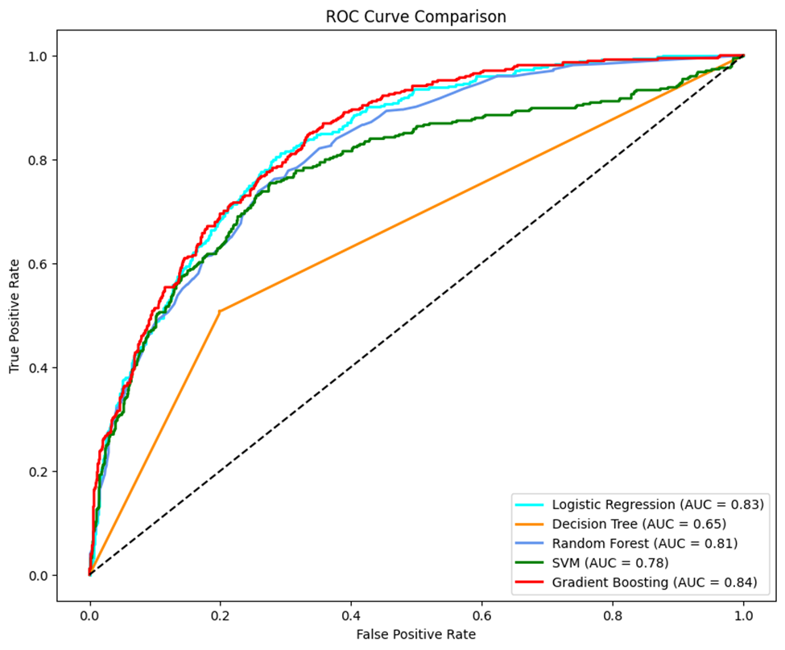
ROC Curve Analysis
Gradient Boosting is the most efficient based on the ROC, it is closer to the upper left corner where the graph suggests high true positive and low false positive.
Logistic Regression and Random Forest also show strong performance, with curves that are slightly below Gradient Boosting.
Support Vector Machine (SVM) performs well, though its ROC curve is slightly lower, reflecting its challenges with recall.
The Decision Tree curve is the least steep, indicating that it may be less reliable in distinguishing between classes compared to the other models.

Slide 16
Recommendations
MARKET SIZE
OUR CLIENTS COME FROM EVERYWHERE
Personalize Offer: Provide special deals or loyalty programs to high-risk customers to keep them engaged.
Customer Segmentation: Use the churn prediction model to segment customers by risk level and design specific retention campaigns for each group.
Flexible Contracts: Offer more flexible or longer-term contract options to reduce churn, especially for month-to-month customers.
Better Support: Focus on improving customer support, particularly for fiber optic users, to reduce churn due to service issues.
Feedback Integration: Use customer feedback and churn data to continuously refine products and services.
Targeted Messaging: Create marketing campaigns that speak directly to the needs of at-risk customers.

Slide 17
Conclusion
Gradient Boosting emerged as the best model for predicting customer churn, with the highest accuracy and ROC-AUC.
Logistic Regression and Random Forest also showed strong performance, making them viable options depending on business needs.
Contract Type: A significant factor in churn, with customers on month-to-month contracts more likely to churn.
Service Type: Fiber optic users showed a higher probability of churn, suggesting the need for targeted retention strategies.

Slide 18
Conestoga College
THANK YOU

